Slide 1
CUSTOMER RELATIONSHIP MANAGEMENT
CONCEPTS AND TECHNOLOGIES
Chapter 14
Sales force automation

Slide 2
Sales force automation definition
Sales Force Automation is the application of computerised technologies to support sales people and sales management in the achievement of their work-related objectives.

Slide 3
Key technologies for SFA
SFA hardware includes desktop, laptop and handheld devices, and contact/call centre technology.
SFA software comprises both ‘point’ solutions that are designed to assist in a single area of selling or sales management, and integrated solutions that offer a range of functionality.

Slide 4
SFA software solutions
SFA specialists | SFA as part of CRM suite | SFA as part of Enterprise suite
Selectica | Onyx | Oracle
EzRoute | Pivotal | SAP
Salesnet | Salesforce.com | Epicor
CallWizard | SalesLogix | Deltek
Selltech | ACCPAC | Fourth Shift
CyberForms | NetCRM | Intentia

Slide 5
SFA functionality
account management | pipeline management
activity management | product encyclopaedias
contact management | product configuration
contract management | product visualization
document management | proposal generation
event management | quotation management
incentive management | sales forecasting
lead management | territory management
opportunity management | work-flow engineering
order management

Slide 6
Account management
Account management offers sales reps and managers a complete view of the customer relationship including contacts, contact history, completed transactions, current orders, shipments, enquiries, service history, opportunities, and quotations. This allows sales reps and account managers to keep track of all their obligations in respect of every account for which they are responsible, whether this is an opportunity to be closed, an order or a service enquiry.

Slide 7
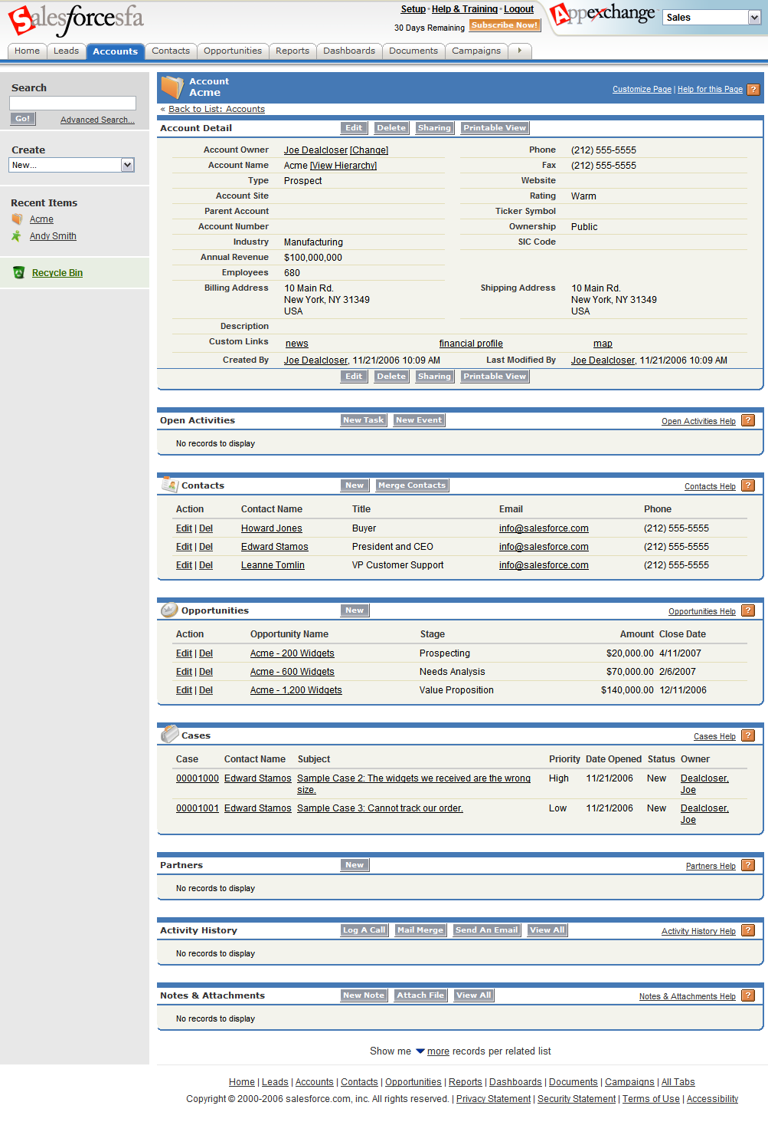
Account management screenshot

Slide 8
Activity management
Activity management keeps sales reps and managers aware of all activities, whether complete or pending, related to an account, contact, or opportunity, by establishing to-do lists, setting priorities, monitoring progress and programming alerts. Activities include preparation of quotations, scheduling of sales calls and following up enquiries, for example.

Slide 9
Contact management
Contact management functionality includes tools for building, sharing and updating contact lists, making appointments, time setting, and task, event and contact tracking .Contact list data includes names, phone numbers, addresses, preference data, and email addresses for people and companies, as well as a history of in-bound and out-bound communications.

Slide 10
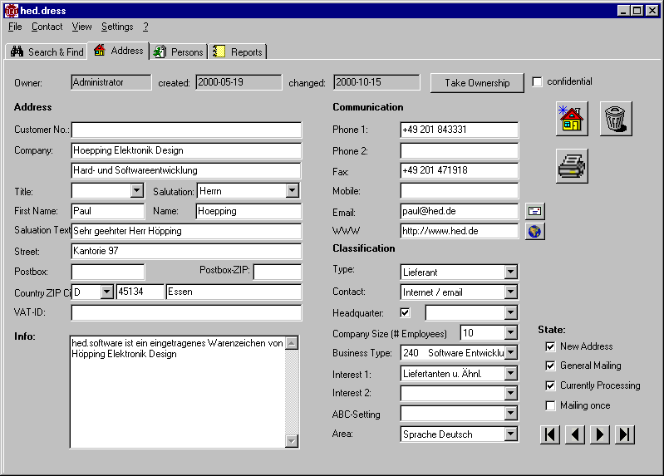
Contact management screenshot

Slide 11
Contract management
Contract management functionality enables reps and managers to create, track, progress, accelerate, monitor and control contracts with customers. Contract management helps manage a contract's lifespan by shortening approval cycles for contracts, renewing contracts sooner, and reducing administrative costs. The software may use security controls to ensure only approved people have access to contracts.

Slide 12
Document management
Companies generate and use many documents as they sell to customers - brochures, product specifications, price lists, competitive comparisons, and templates for preparing quotations, for example. Document management software allows companies to manage these documents, keep them current and ensure that they are available to reps and managers when needed.

Slide 13
Event management
Event management enables reps and managers to plan, implement, control and evaluate events such as conferences, seminars, trade shows, exhibitions and webinars, whether run solo or jointly with customers or other partners.

Slide 14
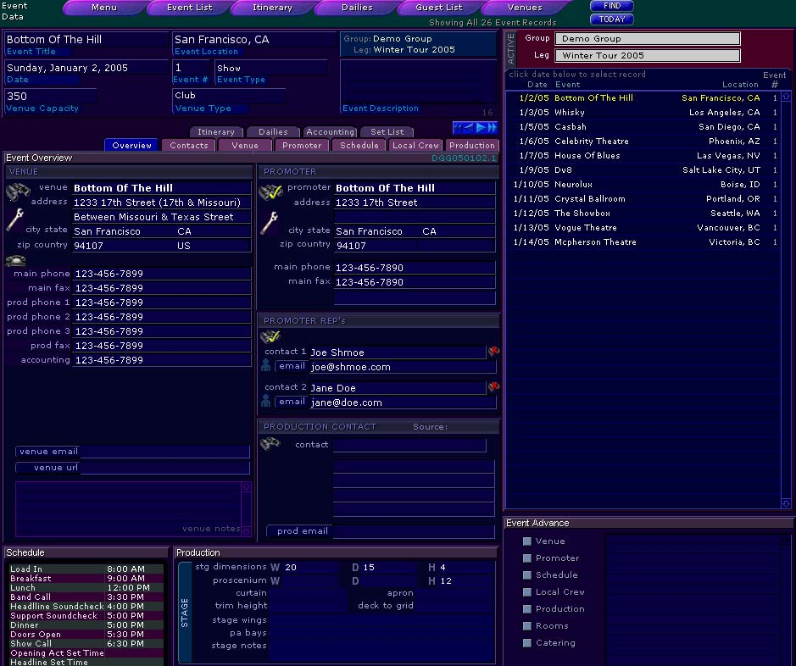
Event management screenshot

Slide 15
Incentive management
Incentive management is an issue for sales managers who use commissions to lift, direct and reward sales reps’ efforts. In many companies, commissions are calculated using stand-alone spreadsheets.

Slide 16
Lead management
Lead management allows companies to create, assign and track sales leads. User-defined rules allow leads to be allocated to reps and account managers on the basis of role, territory, product expertise or other variables.
Lead management allows for more equitable workload distribution across a sales team, and uses security controls to ensure that reps can only access their own leads.

Slide 17
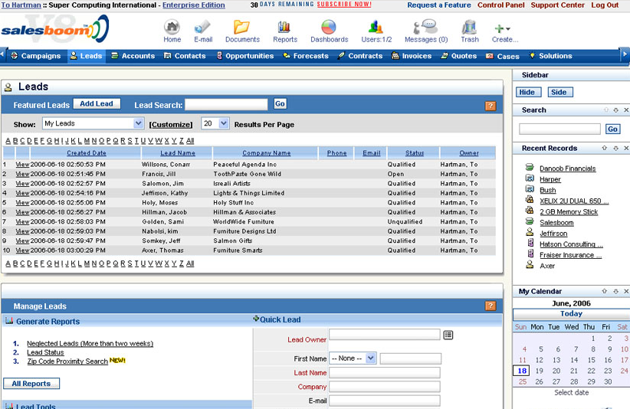
Lead management screenshot

Slide 18
Opportunity management
An opportunity is a record of a potential sale or any other type of revenue generation. Opportunity management software enables reps and managers to create an opportunity record in the database, and monitor progress against a predefined selling methodology.

Slide 19
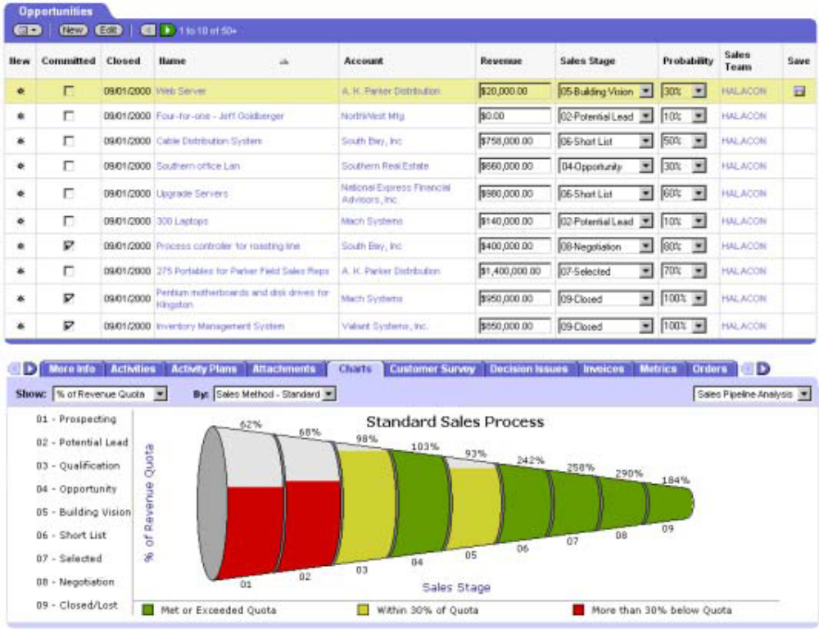
Opportunity management report

Slide 20
Order management
Order management functionality allows reps to convert quotations and estimates into orders once a customer has agreed to buy. If this is done in front of a customer, the order can be loaded into production, or picked from a warehouse, more quickly.
Order management software may include a quotation engine, a pricing module, and a product configurator. With visibility through a portal, the customer, rep and manager has access to the same, up-to-date order information.

Slide 21
Pipeline management
Pipeline management is the process of managing the entire sales cycle from identifying prospects, estimating sales potential, managing leads, forecasting sales, initiating and maintaining customer relationships, right through to closure. A well-defined sales pipeline helps minimize lost opportunities and breakdowns in the sales process.

Slide 22
Product encyclopaedia
A product encyclopaedia is a searchable electronic product catalogue, that generally contains product names, stock numbers, images and specifications. These can be stored on reps computers’ and/or made available to customers online.

Slide 23
Product configuration
Product configuration applications enable salespeople, or customer themselves, automatically to design and price customized products, services or solutions. Configurators are useful when the product is particularly complex or when customization is an important part of the value proposition.

Slide 24
Product visualization
Product visualization software enables sales reps and customers to produce realistic images of products before they are manufactured. This is a useful application when linked to a product configurator. The image can take the form of a simulated photograph, 3-D model or technical drawing, and can include other related documentation such as specifications or prices.

Slide 25
Proposal generation
Proposal generation software allows users to create customized proposals for customers. Users draw from a database of information to create proposals which, typically, are composed of several parts, some of which are customized: cover page and letter, introduction, objectives, products, product features, services, prices, specifications, pictures, drawings, people, experience, resumes, references, approach, schedule, organization, scope of work, and appendices.

Slide 26
Quotation management
Quotation management software allows reps and managers to quote for opportunities. The software allows users to create, edit, approve, and produce costed, customized, proposals quickly and reliably. Some vendors enable users to create multimedia proposals with audio, animation and video.

Slide 27
Sales forecasting
Sales forecasting applications offer sales reps and managers a number of qualitative and quantitative processes to help forecast sales revenues and close rates.

Slide 28
Territory management
Territory management software allows sales managers to create, adjust and balance sales territories, so that sales reps have equivalent workloads and/or opportunities.
Some territory management applications come with a territory management methodology which users can follow when establishing sales territories.
Some applications link to geographic mapping, or geo-demographic, software. The software enables companies to match sales coverage to market opportunity, create sales territory hierarchies (cities, states, regions) and reduce the cost of selling by reducing travel time.
Call cycle scheduling, calendaring and lead management is often enabled by the software.

Slide 29
Workflow engineering
Work-flow engineering software is useful for designing sales-related processes, such as the lead management process, and the event management process. It can even be used to design the selling process itself – the series of steps that a sales rep must follow in shifting a prospect from initial awareness to the close.

Slide 30
Examples of SFA reports
cost-to-serve | sales cycles
customer profitability | share of market
lead conversion | share of wallet
pipeline progress | sales person productivity
quotation performance | win-loss rates

Slide 31
Benefits for SFA stakeholders
Salespeople: shorter sales cycles, more closing opportunities, higher win rates
Sales managers: improved salesperson productivity, improved customer relations, accurate reporting, reduced cost-of-sales
Senior management: accelerated cash flow, increased sales revenue, market share growth, improved profitability

Slide 32
Motivations for implementing SFA
Motivation | % of sample reporting
Improve efficiencies | 72
Improve customer contact | 44
Increase sales | 33
Reduce costs | 26
Improve accuracy | 21

Slide 33
SFA will enhance performance when….. 1
Sales people find that SFA is easy to use
Sales people find the technology useful because it fits their roles well.
Availability of appropriate-to-task SFA training
Users have accurate expectations about what SFA will deliver
Users have a positive attitude towards innovation

Slide 34
SFA will enhance performance when….. 2
Users have a positive attitude towards technology
Availability of user support after roll out, for example, a help desk.
Involvement of user groups including sales reps and managers during project planning and technology selection.
Deployment of a multi-disciplinary team in the project planning phases
Senior management support for SFA.

